Slide 1
CISC 204 - Rush Hour Solver
David Rogers, Chanakya Gajjar, Manraj Juneja, Rishikesh Menon

Slide 2
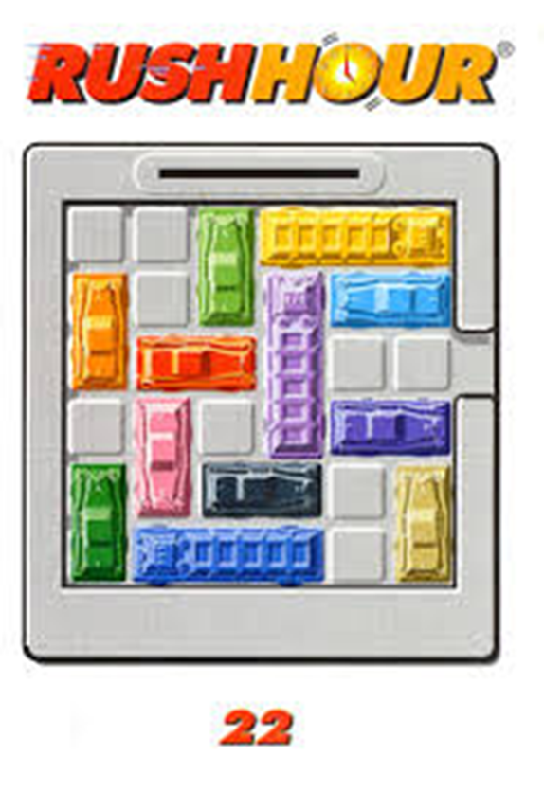
Problem Description
The game rush hour is a basic kids game which involves one red car and a couple of other cars on a 6x6 grid. The goal of the game is to create a free path for the red car to slide out of the perimeter of the board by moving any car that is obstructing the path. Any given car can only move within the axis of its orientation.
The objective of this project is to model the logic that can be used to solve this game.

Slide 3
Prepositions (Options)
Prepositions were modelled in first order logic as Bauhaus Objects
CAR_IDS = [0, 1, 2, 3…] (User specified)
TIME[0, 1, 2, 3…] (User specified)
X_POSITIONS = [0, 1, 2, 3, 4, 5]
Y_POSITIONS = [0, 1, 2, 3, 4, 5]
MOVEMENTS[LEFT, RIGHT, UP, DOWN, HOLD]
ORIENTATIONS[VERTICAL, HORIZONTAL, EMPTY]
CAR_ORIENTATIONS {0:EMPTY, 1:HORIZONTAL, 2:…} (User Specified)

Slide 4
Prepositions Pt. 2
TileState(carId, xPos, yPos, time)
The tile at coordinate (xPos, yPos) is occupied by carId, at time
CarMoves(self, carId, direction, time)
All car tiles of type carId, move in direction, at time
WinState(time)
The game is won at time
ToBeSwapped(xPos, yPos, time)
The empty tile that is at (xPos, yPos) is going to be moved into at time, so don’t hold position for next time iteration.

Slide 5
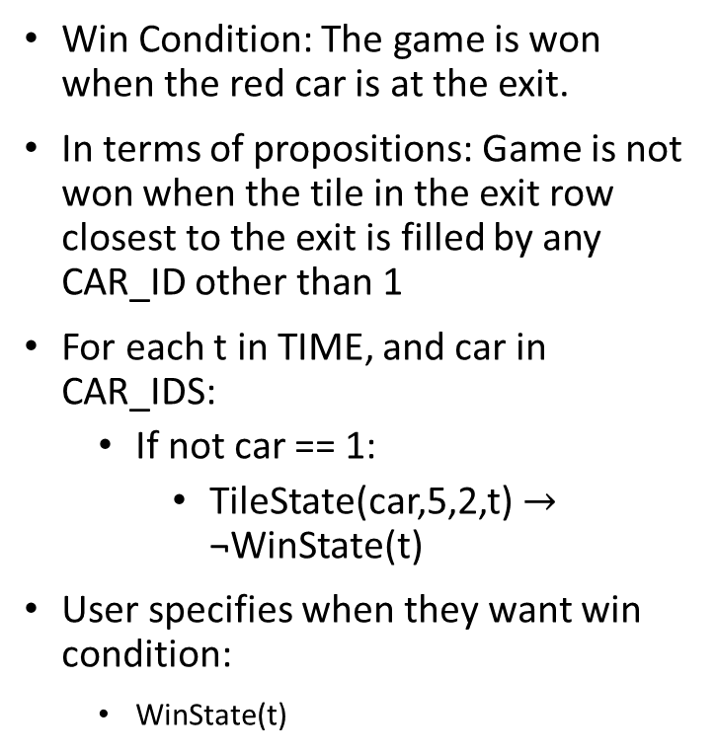
Constraints (Win Condition)
Win Condition: The game is won when the red car is at the exit.
In terms of propositions: Game is not won when the tile in the exit row closest to the exit is filled by any CAR_ID other than 1
For each t in TIME, and car in CAR_IDS:
If not car == 1:
TileState(car,5,2,t) $→$ ¬WinState(t)
User specifies when they want win condition:
WinState(t)

Slide 6

Constraints (At most one car on a tile)
A tile cannot have multiple CAR_IDs at TIME t
For t in TIME, x in X_POSITIONS, y in Y_POSITIONS, c in CAR_IDS, other_car in CAR_IDS
If not c == other_car:
TileState(c,x,y,t) $→$ ¬ TileState(other_car,x,y,t)

Slide 7
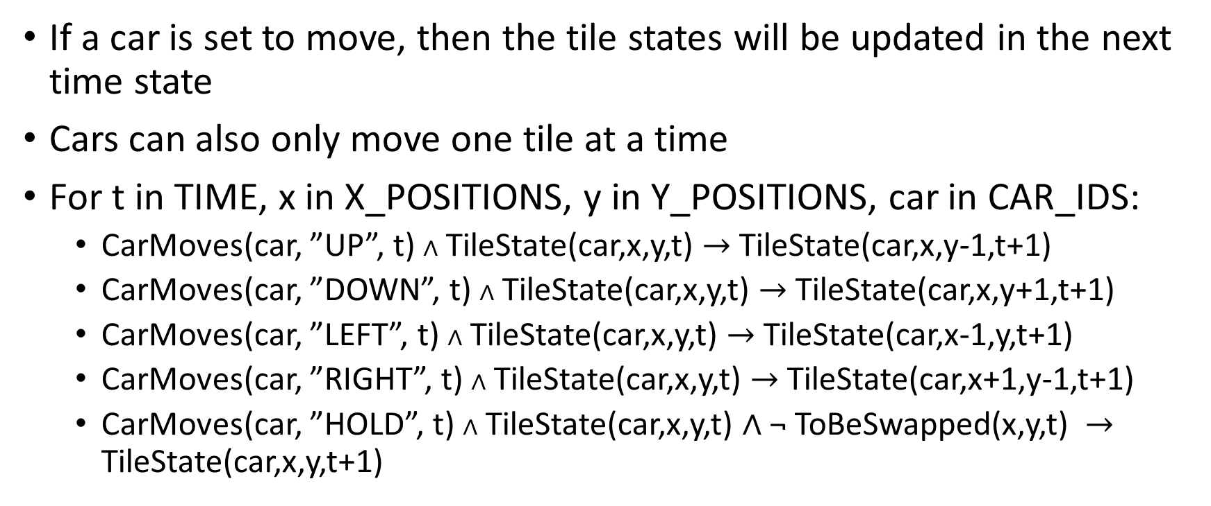
Constraints (Car movement updates tile states)
If a car is set to move, then the tile states will be updated in the next time state
Cars can also only move one tile at a time
For t in TIME, x in X_POSITIONS, y in Y_POSITIONS, car in CAR_IDS:
CarMoves(car, ”UP”, t) $∧$ TileState(car,x,y,t) $→$ TileState(car,x,y-1,t+1)
CarMoves(car, ”DOWN”, t) $∧$ TileState(car,x,y,t) $→$ TileState(car,x,y+1,t+1)
CarMoves(car, ”LEFT”, t) $∧$ TileState(car,x,y,t) $→$ TileState(car,x-1,y,t+1)
CarMoves(car, ”RIGHT”, t) $∧$ TileState(car,x,y,t) $→$ TileState(car,x+1,y-1,t+1)
CarMoves(car, ”HOLD”, t) $∧$ TileState(car,x,y,t) $∧$ ¬ ToBeSwapped(x,y,t) $→$ TileState(car,x,y,t+1)

Slide 8
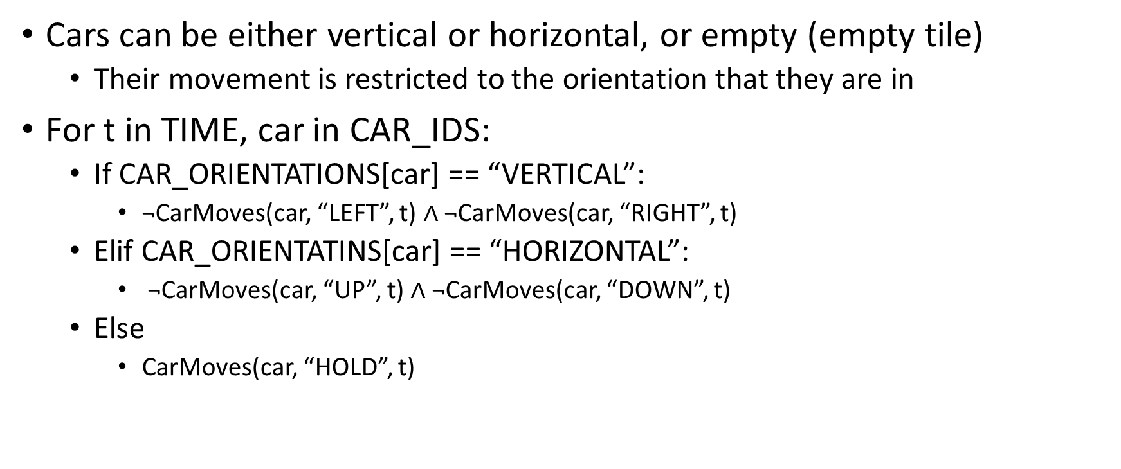
Constraints (Cars can only move in their axis)
Cars can be either vertical or horizontal, or empty (empty tile)
Their movement is restricted to the orientation that they are in
For t in TIME, car in CAR_IDS:
If CAR_ORIENTATIONS[car] == “VERTICAL”:
¬CarMoves(car, “LEFT”, t) $∧$ ¬CarMoves(car, “RIGHT”, t)
Elif CAR_ORIENTATINS[car] == “HORIZONTAL”:
¬CarMoves(car, “UP”, t) $∧$ ¬CarMoves(car, “DOWN”, t)
Else
CarMoves(car, “HOLD”, t)

Slide 9
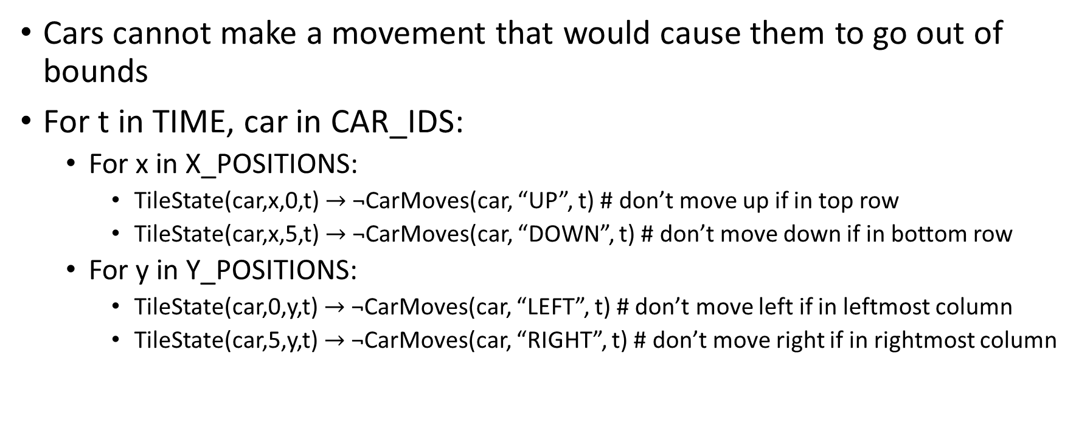
Constraints (A car must stay in bounds)
Cars cannot make a movement that would cause them to go out of bounds
For t in TIME, car in CAR_IDS:
For x in X_POSITIONS:
TileState(car,x,0,t) $→$ ¬CarMoves(car, “UP”, t) # don’t move up if in top row
TileState(car,x,5,t) $→$ ¬CarMoves(car, “DOWN”, t) # don’t move down if in bottom row
For y in Y_POSITIONS:
TileState(car,0,y,t) $→$ ¬CarMoves(car, “LEFT”, t) # don’t move left if in leftmost column
TileState(car,5,y,t) $→$ ¬CarMoves(car, “RIGHT”, t) # don’t move right if in rightmost column

Slide 10
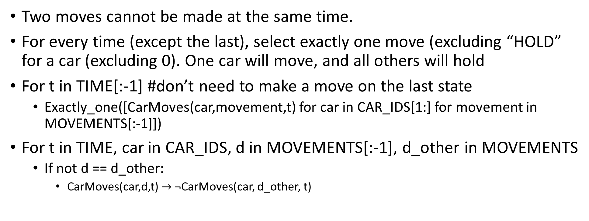
Constraints (Exactly one move at a time)
Two moves cannot be made at the same time.
For every time (except the last), select exactly one move (excluding “HOLD” for a car (excluding 0). One car will move, and all others will hold
For t in TIME[:-1] #don’t need to make a move on the last state
Exactly_one([CarMoves(car,movement,t) for car in CAR_IDS[1:] for movement in MOVEMENTS[:-1]])
For t in TIME, car in CAR_IDS, d in MOVEMENTS[:-1], d_other in MOVEMENTS
If not d == d_other:
CarMoves(car,d,t) $→$ ¬CarMoves(car, d_other, t)

Slide 11
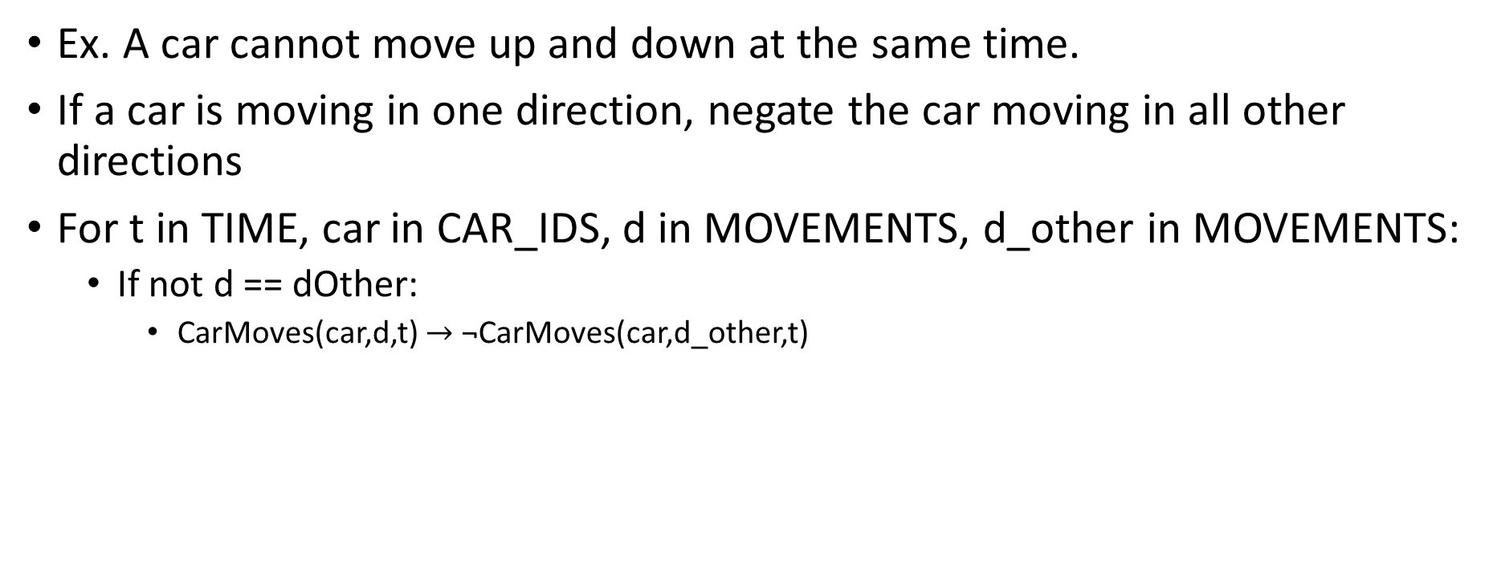
Constraints (A car can only move in one direction at a time)
Ex. A car cannot move up and down at the same time.
If a car is moving in one direction, negate the car moving in all other directions
For t in TIME, car in CAR_IDS, d in MOVEMENTS, d_other in MOVEMENTS:
If not d == dOther:
CarMoves(car,d,t) $→$ ¬CarMoves(car,d_other,t)

Slide 12
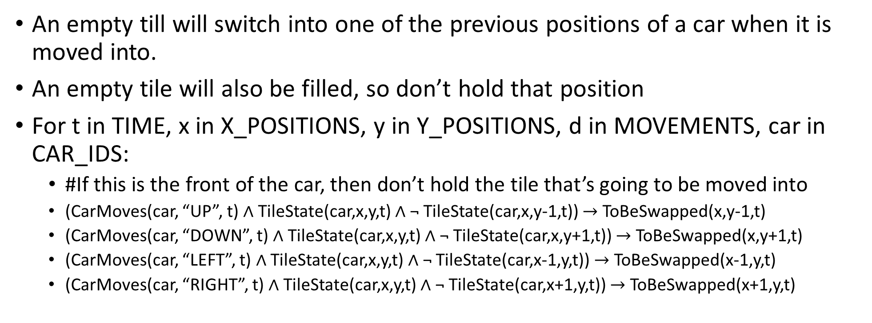
Constraints (Tile swapping)
An empty till will switch into one of the previous positions of a car when it is moved into.
An empty tile will also be filled, so don’t hold that position
For t in TIME, x in X_POSITIONS, y in Y_POSITIONS, d in MOVEMENTS, car in CAR_IDS:
#If this is the front of the car, then don’t hold the tile that’s going to be moved into
(CarMoves(car, “UP”, t) $∧$ TileState(car,x,y,t) $∧$ ¬ TileState(car,x,y-1,t)) $→$ ToBeSwapped(x,y-1,t)
(CarMoves(car, “DOWN”, t) $∧$ TileState(car,x,y,t) $∧$ ¬ TileState(car,x,y+1,t)) $→$ ToBeSwapped(x,y+1,t)
(CarMoves(car, “LEFT”, t) $∧$ TileState(car,x,y,t) $∧$ ¬ TileState(car,x-1,y,t)) $→$ ToBeSwapped(x-1,y,t)
(CarMoves(car, “RIGHT”, t) $∧$ TileState(car,x,y,t) $∧$ ¬ TileState(car,x+1,y,t)) $→$ ToBeSwapped(x+1,y,t)

Slide 13
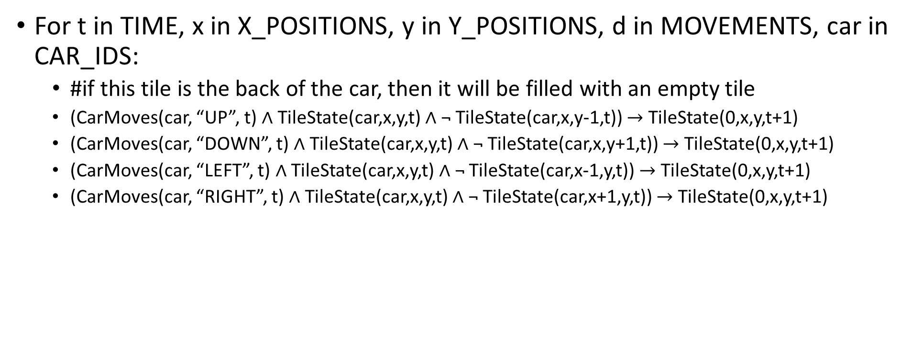
Constraints (Tile Swapping Cont.)
For t in TIME, x in X_POSITIONS, y in Y_POSITIONS, d in MOVEMENTS, car in CAR_IDS:
#if this tile is the back of the car, then it will be filled with an empty tile
(CarMoves(car, “UP”, t) $∧$ TileState(car,x,y,t) $∧$ ¬ TileState(car,x,y-1,t)) $→$ TileState(0,x,y,t+1)
(CarMoves(car, “DOWN”, t) $∧$ TileState(car,x,y,t) $∧$ ¬ TileState(car,x,y+1,t)) $→$ TileState(0,x,y,t+1)
(CarMoves(car, “LEFT”, t) $∧$ TileState(car,x,y,t) $∧$ ¬ TileState(car,x-1,y,t)) $→$ TileState(0,x,y,t+1)
(CarMoves(car, “RIGHT”, t) $∧$ TileState(car,x,y,t) $∧$ ¬ TileState(car,x+1,y,t)) $→$ TileState(0,x,y,t+1)

Slide 14
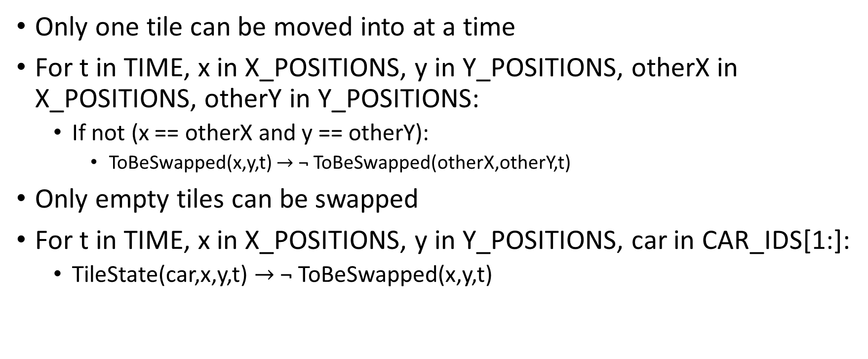
Constraints (Only one tile swapped at a time, and it must be empty)
Only one tile can be moved into at a time
For t in TIME, x in X_POSITIONS, y in Y_POSITIONS, otherX in X_POSITIONS, otherY in Y_POSITIONS:
If not (x == otherX and y == otherY):
ToBeSwapped(x,y,t) $→$ ¬ ToBeSwapped(otherX,otherY,t)
Only empty tiles can be swapped
For t in TIME, x in X_POSITIONS, y in Y_POSITIONS, car in CAR_IDS[1:]:
TileState(car,x,y,t) $→$ ¬ ToBeSwapped(x,y,t)

Slide 15
Constraints (Starting Board State)
Starting board configuration is set by the user
Ex:
BOARD_ARRAY = [
[0,0,0,0,0,0],
[0,0,0,0,0,2],
[0,0,0,1,1,2], # <-EXIT
[0,0,0,0,0,0],
[0,0,0,0,0,0],
[0,0,0,0,0,0]
]
Starting constraints are set by interpreting array:
For y in Y_POSITIONS, x in X_POSITIONS:
TileState(BOARD_ARRAY[y][x],x,y,0)

Slide 16
Model Exploration Pt. 1 (WinState Optimizations)
The original WinState conditions required that both tiles to the immediate left of the exit be occupied by CAR_ID 1.
This constraint could be simplified to only require one tile to the immediate left of the exit be CAR_ID 1. This would ensure that the red car was at the exit, and could rely on other game constraints (all car tiles moving together, and no intersecting tiles), to ensure that the entire red car was aligned with the exit.
This was timed and tested using python’s datetime module, but no difference was found in solving time.
Additionally, the WinState was once simplified to assert a win on the condition that all tiles between the red car and the exit were empty.
This made a notable difference in solution time in solutions that had the red car on the far left of the board, with few obstacles in the way (96% reduction in solution time)
Although this was a notable efficiency boost, it was only realized in cases like that mentioned above, and did not show the full solution of the car leaving the board as required in the game rules.
To follow the game rules, this feature was taken out.

Slide 17
Model Exploration Pt. 2 (Solver Limits)
Due to the complexity of this model, the solver takes exponentially more time given more complex board arrangements.
Need to limit number of moves (Table. 1)
Limited to one car on board
Need to limit number of cars (Table. 2)
Limited to one move to solution
A 3 move solution with 3 cars requires > 4 hours
Don’t count total solutions
We quickly discovered that counting the total number of solutions, without limiting the number of moves was a poor idea, and would generate infinite solutions.
This was discovered at ~26gb of used RAM
# of Moves | Completion time (S)
0 | 1.53
1 | 14.36
2 | 48.70
3 | 100.27
4 | 191.32
# of Cars | Completion time (S)
1 | 14.94
2 | 41.60
3 | 77.12
4 | 83.25

Slide 18
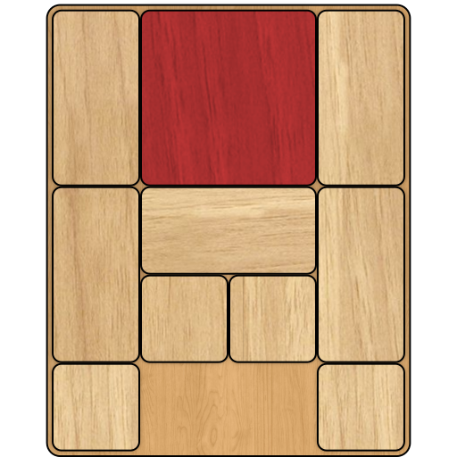
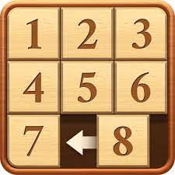
Model Exploration Pt. 3 (Breaking Game Rules)
By removing the constraint that cars can only move in one axis, its possible to extend the game to a much more common Klotski sliding block puzzle, that has been around for hundreds of years. This allows blocks to move around in all 4 directions.
When testing this as a Klotski solver, solution times were similar, however many boards that were unsolvable became solvable with this new logic.
A simple example was if the red car was not in the exit row, it could just move vertically into the exit row, and then move right into the win position.
Alternatively, the solver was also modified to solve a ordered block puzzle.
Set win condition to require tiles in exact positions on right
Set 35 1x1 cars, that can move in all 4 direction
Could only solve if < 2 moves, otherwise took hours without solution

Slide 19
First Order Extension (Prepositions)
The vast majority of this project was modelled using first-order logic, since all prepositions were implemented through Bauhaus objects.
The only preposition that would need converting to predicate logic would be the CAR_ORIENTATIONS dictionary. It could be replaced as 3 Bauhaus prepositional objects of the following structure:
@proposition(E)
class IsVertical(Unique):
def __init__(self, carId):
self.carId = carId
@proposition(E)
class IsHorizontal(Unique):
def __init__(self, carId):
self.carId = carId
@proposition(E)
class IsEmpty(Unique):
def __init__(self, carId):
self.carId = carId

Slide 20
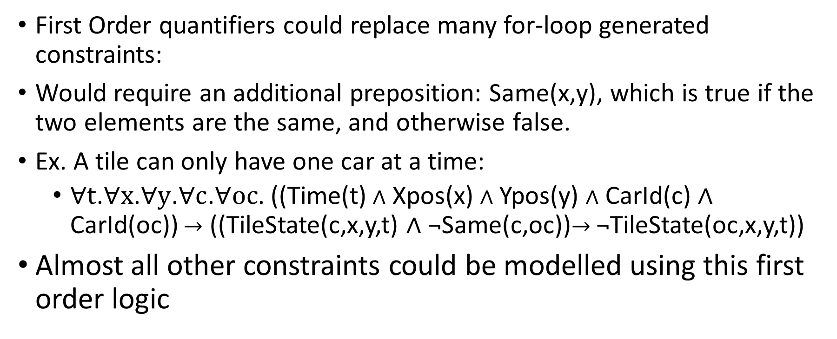
First Order Extension (Constraint Loops)
First Order quantifiers could replace many for-loop generated constraints:
Would require an additional preposition: Same(x,y), which is true if the two elements are the same, and otherwise false.
Ex. A tile can only have one car at a time:
$∀t$.$∀x$.$∀y$.$∀c$.$∀oc$. ((Time(t) $∧$ Xpos(x) $∧$ Ypos(y) $∧$ CarId(c) $∧$ CarId(oc)) $→$ ((TileState(c,x,y,t) $∧$ ¬Same(c,oc))$→$ ¬TileState(oc,x,y,t))
Almost all other constraints could be modelled using this first order logic

Slide 21
First Order Extension (Starting Constraints)
The starting condition constraints could not be easily implemented through first order quantifiers.
These constraints are generated by the starting array, and could not be generalized using existential/universal quantifiers.

Slide 22
Jape Proof 1
Simulating the movement of the red car from start to finish and concluding that the car is in the winning state (Q). The red car can move right by 1 unit only if the tile next to it is not occupied by other cars. If the next tile is occupied by another car it needs to be moved for us to be able to move the red car. For this case, we take the following example:
EXIT

Slide 23
PREMISES:
S<x><y><car>, where x stands for the X coordinate and y stands for the Y coordinate. Car represents the color of the tile or if it is empty.
(S02R ∧ S12R), (S21B ∧ S22B), (S32E ∧ S42E), (S52B ∧ S53B). These are used to set up the initial positions in the game.
(S02R ∧ S12R ∧ S22E ) --> (S02E ∧ S12R ∧ S22R), (S12R ∧ S22R ∧ S32E ) --> (S12E ∧ S22R ∧ S32R), ……, (S32R ∧ S42R ∧ S52E ) --> (S32E ∧ S42R ∧ S52R). These show that if the tile next to the red car is empty, a movement is made to the right.
T is a set of moves that will move the blue tile in the way to make it empty.
S22B --> ( T --> S22E),……, S52B --> ( T --> S52E). These show that when a tile is blue, moves T are made which results in the tile ending up empty and available for movement.
S42R ∧ S52R --> Q. This represents that when the tiles at these positions are red, it means that we have won the game.

Slide 24
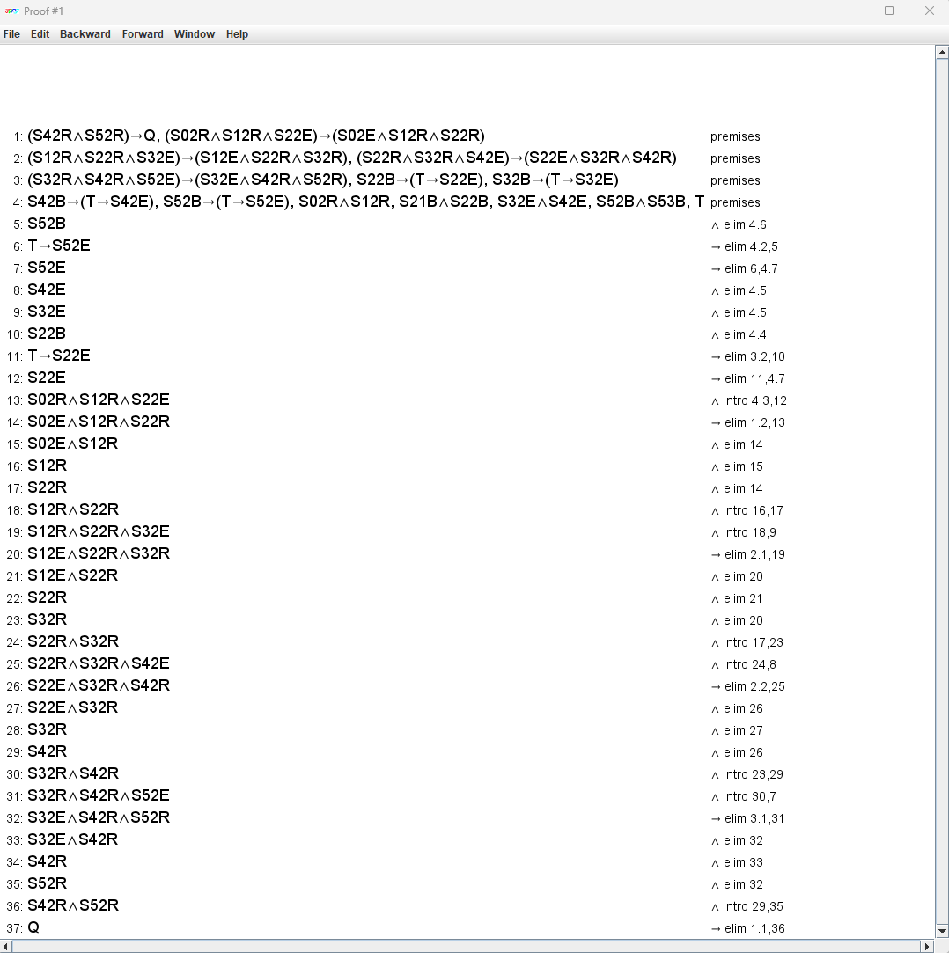
Image of proof 1:

Slide 25
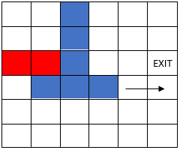
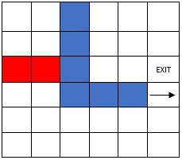
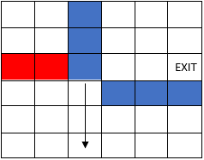
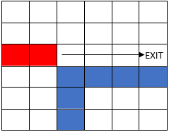
JAPE PROOF 2:
Modelling a state when the red car is blocked by a vertical car and the vertical car is blocked by horizontal car. This state would require the horizontal car to move right 2 steps and the vertical car to move down two steps in order to give the red car a clear path to the exit (This would require the red car to move 4 steps).
Each spot on the board will have a unique representation of the form S<x><y><car>, where x stands for the X coordinate and y stands for the Y coordinate.

Slide 26
The premises defined are the representation of the cars and empty spaces on the board.
The first 8 premises (S13B→¬S13E, S23B→¬S23E, S33B→¬S33E, S20B→¬S20E, S21B→¬S21E, S22B→¬S22E, S02R→¬S02E, S12R→¬S12E) show that if a tile is occupied by either a red or blue car the tile cannot be empty.
The next 9 premises((S13B∧S23B∧S33B∧S43E)→(S13E∧S23B∧S33B∧S43B),(S23B∧S33B∧S43B∧S53E)→(S23E∧S33B∧S43B∧S53B), (S20B∧S21B∧S22B∧S23E)→(S20E∧S21B∧S22B∧S23B),(S21B∧S22B∧S23B∧S24E)→(S21E∧S22B∧S23B∧S24B), (S22B∧S23B∧S24B∧S25E)→(S22E∧S23B∧S24B∧S25B),(S02R∧S12R∧S22E)→(S02E∧S12R∧S22R), (S12R∧S22R∧S32E)→(S12E∧S22R∧S32R),(S22R∧S32R∧S42E)→(S22E∧S32R∧S42R), (S32R∧S42R∧S52E)→(S32E∧S42R∧S52R) are the representations of the cars movements in the form that if a car is occupying 3 tiles and the tile in front is empty it implies that the car moves forward and the tile that was in front would now be occupied and the tile that was at the end of the car becomes empty.
The 9 premises each model one movement of the car by updating the tile in front and at the end.
The game can only be won when the red car is at 4,2 and 5,2 (S42R∧S52R)→P
The last few premises ((S13B∧S23B∧S33B), (S20B∧S21B∧S22B), (S02R∧S12R), S24E, S25E, S43E, S53E, S32E, S42E, S52E⊢P) are the initial conditions of the board which model where each car is placed and what spaces are empty.

Slide 27
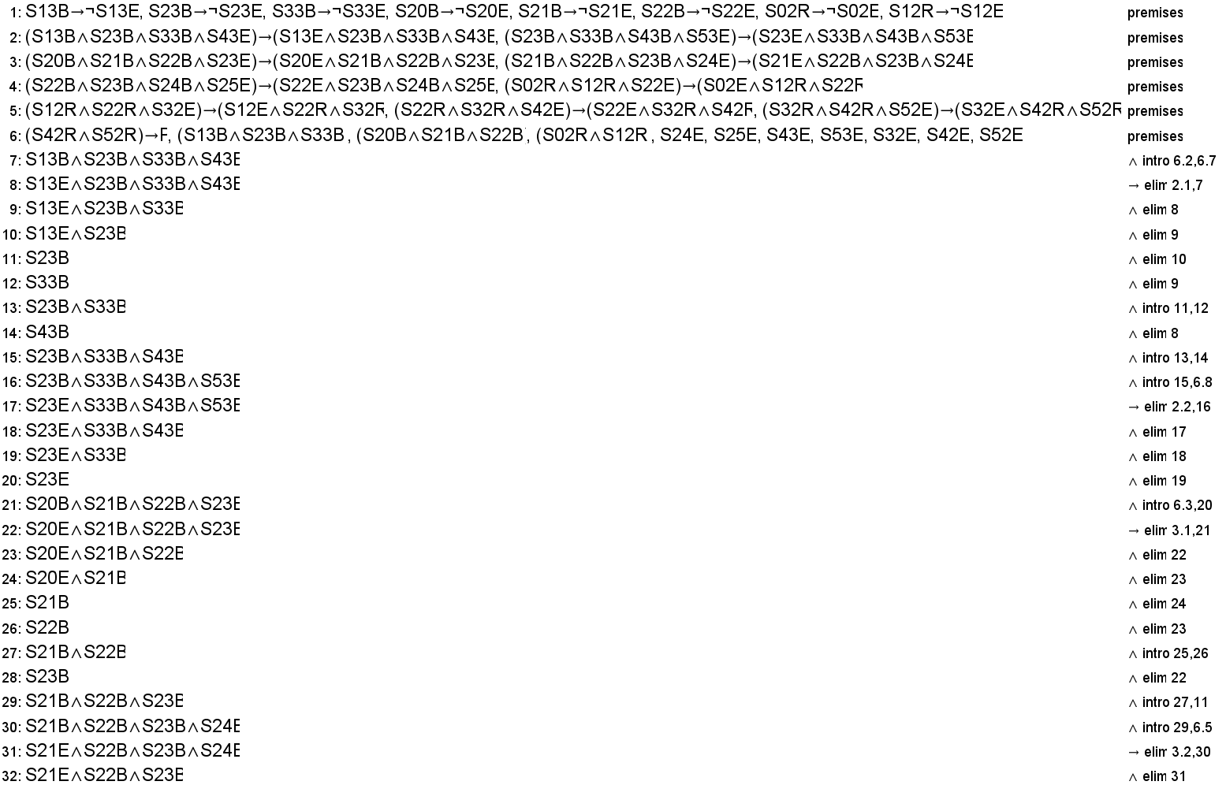
Image of Proof 2:

Slide 28
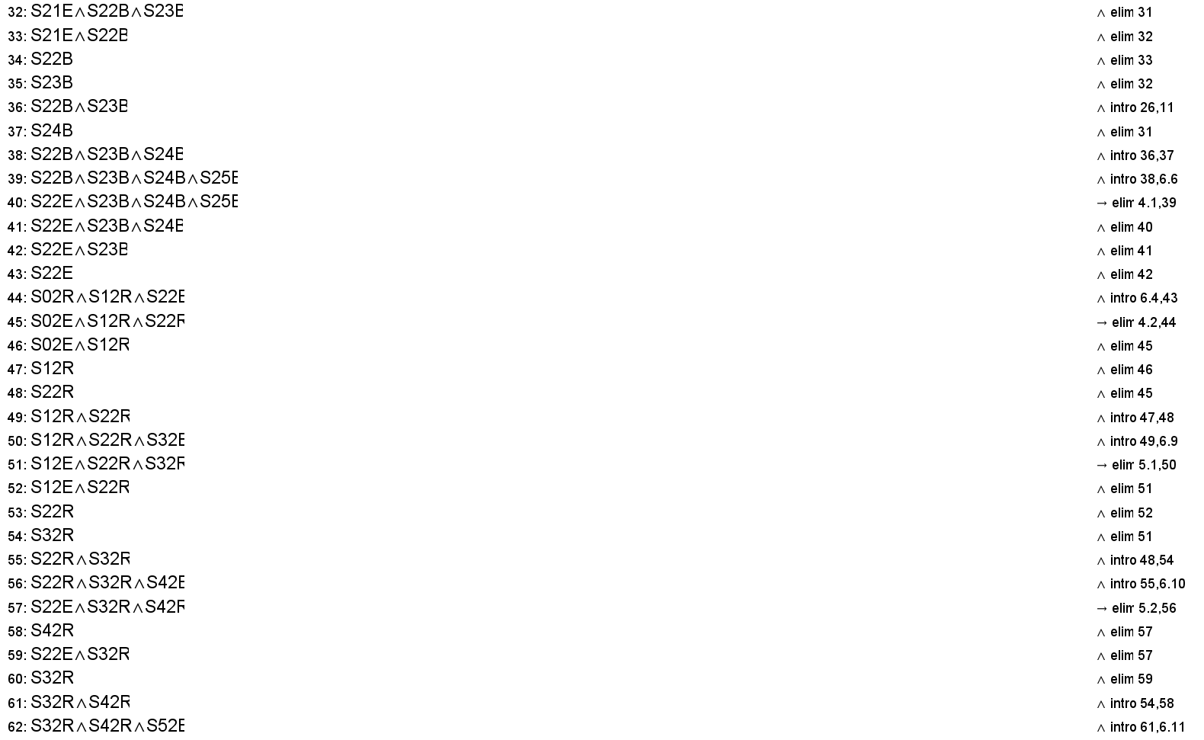

Slide 29
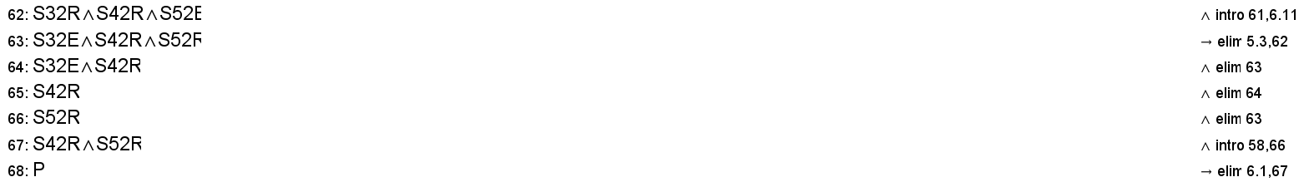

Slide 30
Jape Proof 3
Proof: If the last row is occupied by two 3-unit vertical blue cars, the game becomes unsolvable since the cars are blocking the exit and are immovable.
EXIT

Slide 31
Here, S<x><y><car> is used to represent the content of a single tile.
x ranges from 0 to 5 representing the columns.
y ranges from 0 to f representing the rows.
car consists of either R, B or E, being red, blue and empty.
P refers to the game being solvable.
Q and R refer to the immobility of the two blue cars in the last column.
T refers to the state of the game where no more move is possible.
The following are the premises:
If a tile is filled by a blue car, it is not empty:
S02B -> ~S02E,
S12B -> ~S12E, …....
The red car can be moved to the right if the tile to the right of it is empty (for this proof, the red car is placed at S32 and S42):
(S32R & S42R & S52E) -> S32E & S42R & S52R
The blue car can be moved vertically depending on the tile above/below it being empty (For this proof, we are only considering the last column):
(S50B & S51B & S52B & S53E) -> S50E & S51B & S52B & S53B
(S52E & S53B & S54B & S55B) -> S52B & S53B & S54B & S55E

Slide 32
The cars are immovable if the tile above/below them is occupied and they can't move in the other direction:
Q and R represent the immobility of the two vertical cars respectively.
(S50B & S51B & S52B & ~S53E) -> Q
(S53B & S54B & S55B & ~S52E) -> R
For example, for car 1, since S53E is occupied and it can't move above since it is at the end of the board, it is immobile.
If the red car reaches S42 and S52, that means it has reached the exit, which implies that the game is solvable:
P represents the the game to be a solvable one.
(S42R & S52R) -> P
Both the cars in the last column are immovable, this makes the entire column unchangeable, resulting in a state where no more moves can be made:
Q & R -> T
Since the game is in a state where no more moves can be made and the car has still not reached the exit, the game is unsolvable:
T -> ~P
Given state of the board:
Red car at S32 and S42 and the two 3-unit blue vertical cars in the last column respectively:
S32R & S42R
S50B & S51B & S52B
S53B & S54B & S55B

Slide 33
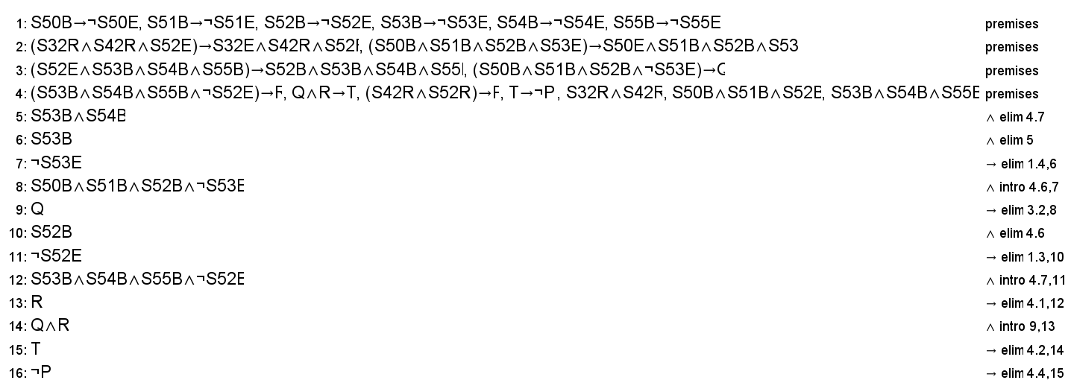
Image of proof 3:

